Slide 1
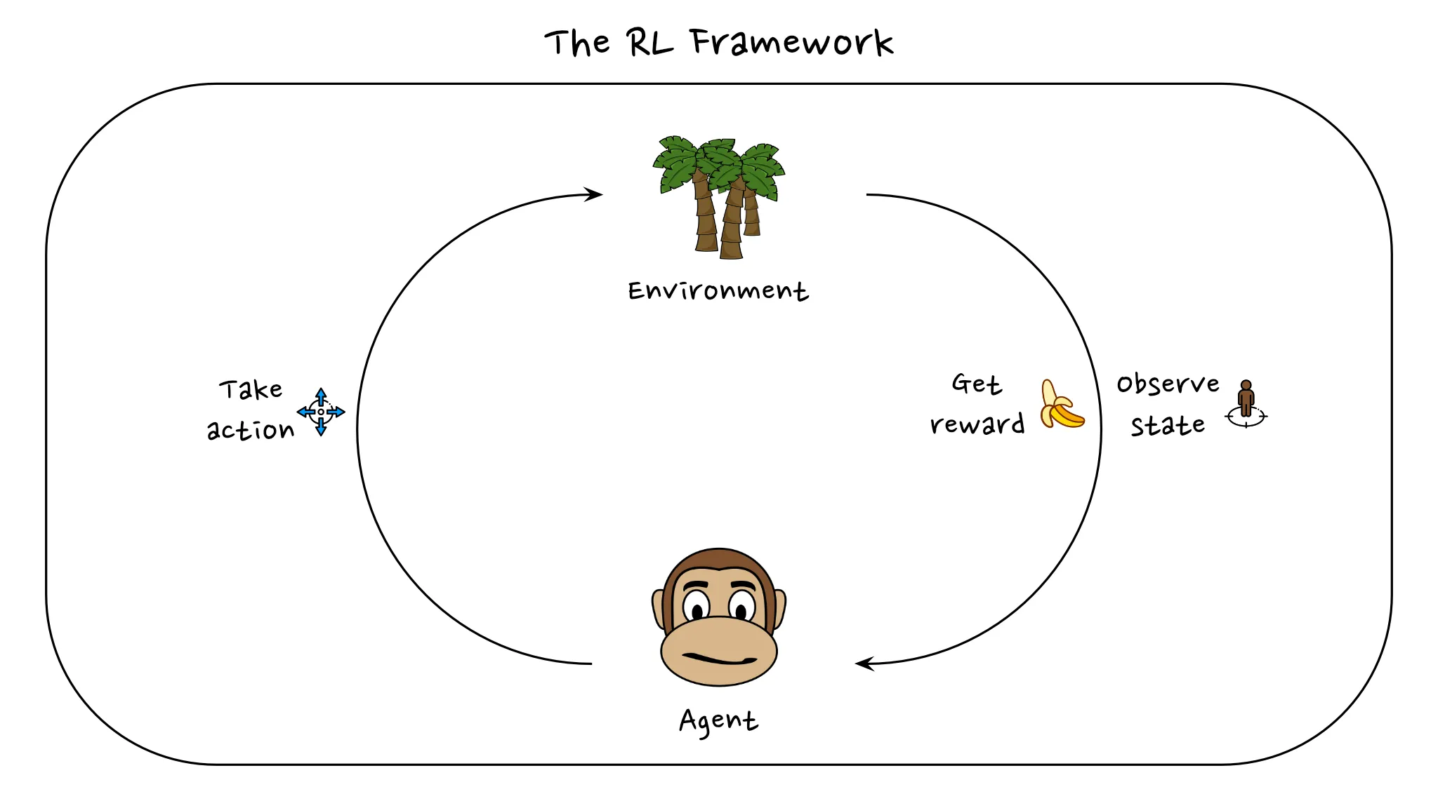
Introduction to Reinforcement Learning
Michael Mollel (PhD)
Link to the project: GitHub
Link to the model: HF

Slide 2
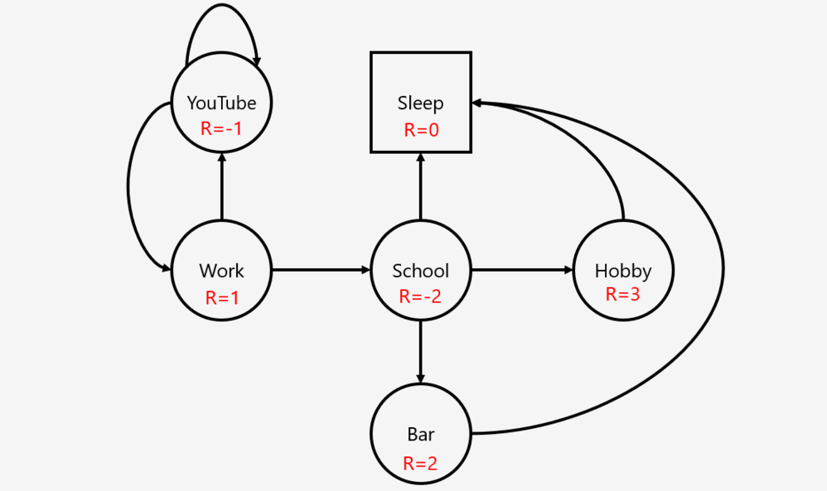
What is RL
Reinforcement learning is a framework for learning any task.
Any problem that is phrased as a Markov Decision Process (Markov Next Slide)
Why RL
RL can help us with finding novel solutions to problems, without explicitly programming tactics or solution methods.
Why is RL

Slide 3
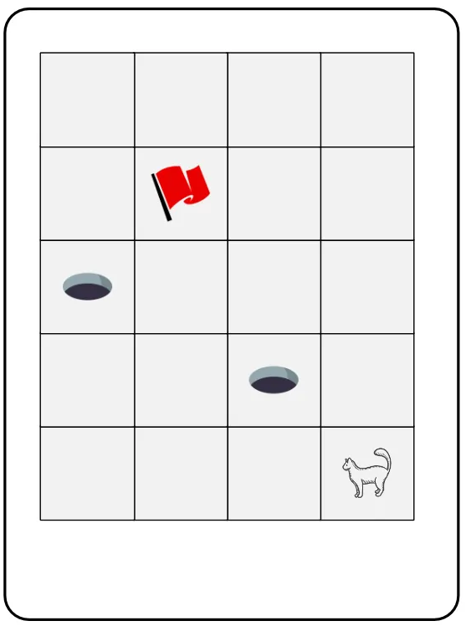
Application of RL
Advertising (The ads you see on your browser)
Finance (when to buy and when to sell)
Healthcare (Drug design)
NLP Large Language Models (Model alignment)
Agent: A thing that tries to solve a problem
Action: a decision taken by the agent
State: A circumstance that the agent sees or observe
Reward: Incentive given to agent after taking Action
Environment: a complete picture of the world
RL - Terminology and Basic
State
Environment
- Reward
Action
Agent

Slide 4

Basic Description of RL
An agent that tries to solve a task in a particular environment and state s
At every timestep t, the agent needs to choose an action a.
After this action, it might receive a reward r
And get a new observation of its states

Slide 5

Basic Branches of ML and Why RL
Supervised
Unsupervised
Semi-Supervised
Reinforcement
Answer: Yes
Challenges
Sample (in-)efficiency
The exploration-exploitation trade-off
The sparse-reward problem
RL – can be applied to all MDP Tasks
Challenges

Slide 6
Sample (in-) Efficiency
Sample is an interaction with the environment.
Most RL Algo needs a lot of samples/interactions to be able to solve a task.
For a human, it takes a few moves to understand good moves or bad.
Human can reuse some of the knowledge and skills already acquired from other experiences throughout their life.
RL-agent in contrast, starts the learning process without any assumptions.

Slide 7
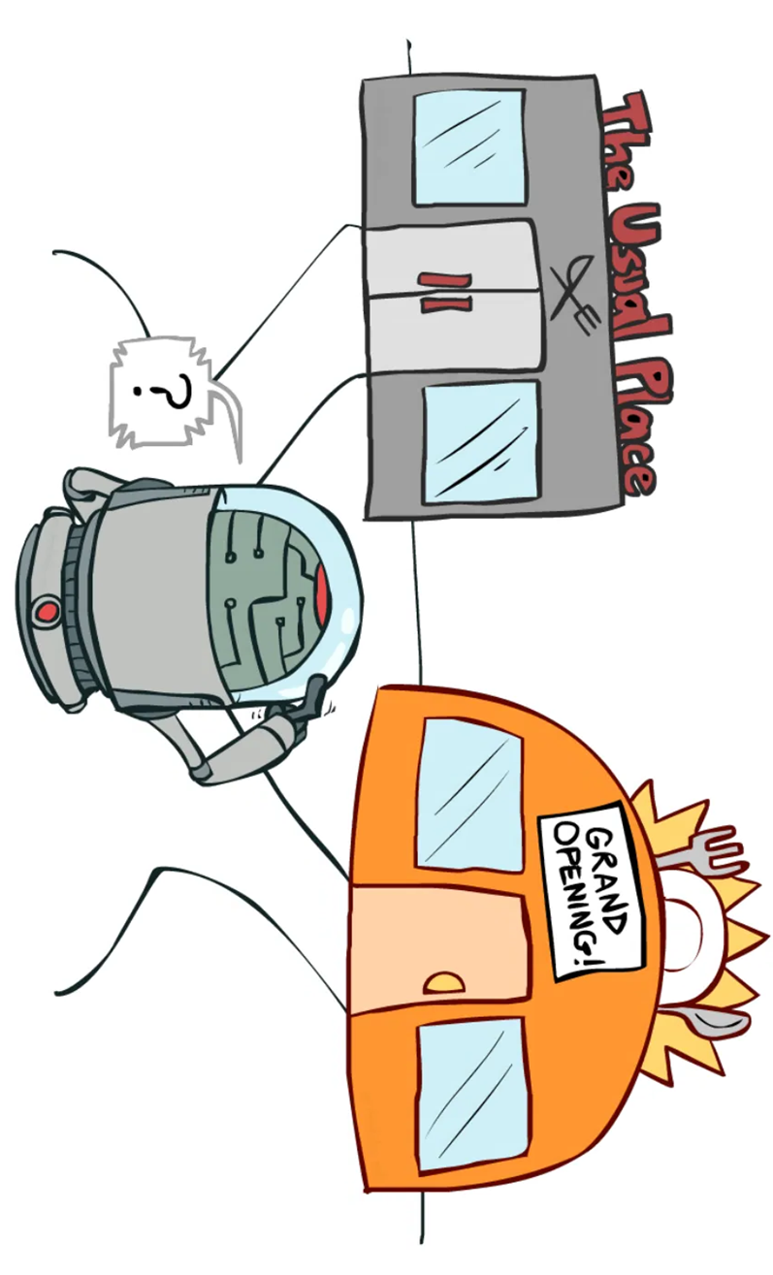
Exploration-exploitation trade-off
Choose between usual and unusual places. What if I choose an unusual place and get rich or get killed?
How often I can choose to explore the unusual place
This is the exploration-exploitation trade-off, we want an automated way to strike a good balance between letting the agent explore and taking actions for which it already knows what they will lead to.
For a lot of problems, it is quite possible that the agent gets stuck in a local optimum
One of the hardest problems for RL to solve

